Slide 1
Long Short Term Memory(LSTM) and (GRU)
Time Series or Sequence Analysis

Slide 2
Vanishing Gradient Problem with RNN
To overcome Vanishing Gradient Problem RNN can also use
Different Activation Function
Batch Normalization
Different Weight Initialization
However because of length of time series input, these could slow down training
A possible solution would be to just shorten the time steps used of prediction, but makes the model worse at predicting longer trends.

Slide 3
LSTM
RNN is great: can remember anything
RNN stinks: remembers everything
Sometimes important to forget: LSTM

Slide 4
LSTM
Another issue with RNN face is that after a while the network will begin to “forget” the first inputs, as information is lost at each step going through the RNN.
We need some sort of “Long term memory” for our networks.
LSTM was created to help these RNN issues.
Lets go through how an LSTM cell works.

Slide 5
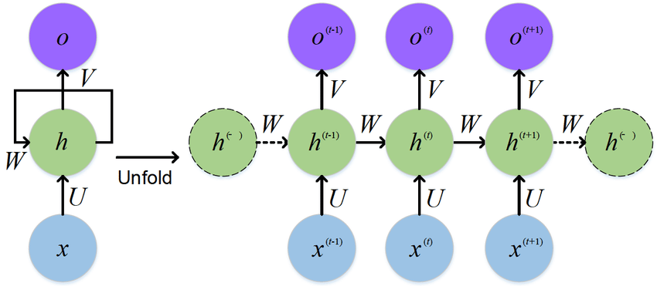
Typical RNN

Slide 6
RNN
6
Output t-1
Output t
H t-1
H t
Input t
X t

Slide 7
RNN
Ht=tanh(W[Ht-1,Xt)+b)
H t-1
H t
X t

Slide 8
LSTM
8
Output at time t
Long Term Memory
New Long term Memory
New Short term Memory
Short Term Memory
Input at time t
Repeating term 4 Layer

Slide 9
LSTM
9
9
Output at time t
Long Term Memory
Forget Gate
Output Gate
New Long term Memory
Input Gate
Update Gate
New Short term Memory
Short Term Memory
Input at time t
Repeating term 4 Layer

Slide 10
Gate
Gates optionally let information through
Multiply vector dimension by value in [0,1]
Zero means : forget everything
One means : carry through unchanged
LSTM has different gates
σ
X
1
0

Slide 11
LSTM
11
h_{t}
C_{t-1}
C_{t}
h_{t}
h_{t-1}
Xt

Slide 12
LSTM
12
h_{t}
C_{t-1}
X
+
C_{t}
tanh
f_{t}
X
X
σ
σ
tanh
σ
h_{t}
h_{t-1}
Xt
Forget gate=f_{t}=σ(W_{f} * [h_{t-1},x_{t}]+b_{f})

Slide 13
LSTM
13
h_{t}
C_{t-1}
X
+
C_{t}
tanh
X
X
i_{t}
Ci_{t}
σ
σ
tanh
σ
h_{t}
h_{t-1}
Xt
Value going to Update i_{t}=σ(W_{f} * [h_{t-1},x_{t}]+b_{i}
New Value Ci_{t}=tanh(Wc * [h_{t-1},x_{t}]+b_{c}

Slide 14
LSTM
14
h_{t}
C_{t-1}
X
+
C_{t}
tanh
f_{t}
X
X
σ
σ
tanh
σ
h_{t}
h_{t-1}
Xt
Interpolate new cell state
Internal state=C_{t} = f_{t} * C_{t-1} + i_{t} * Ci_{t}

Slide 15
LSTM
15
h_{t}
C_{t-1}
X
+
C_{t}
tanh
X
f_{t}
X
σ
σ
tanh
σ
h_{t}
h_{t-1}
Xt
Output gate O_{t}=σ(W_{f} * [h_{t-1},x_{t}]+b_{o}
Hidden state=h_{t} =O_{t} * tanh(C_{t})

Slide 16
Gated Recurrent Unit(GRU)
16
16
Update
gate
Long Term Memory
Forget Gate
Current memory
New Long term Memory
Input Gate
Reset Gate
New Short term Memory
Short Term Memory
Input at time t
Update Gate-how much to retain
Reset Gate-how much to forget
Current Memory -inside reset gate,
reduce effect of previous on future
Variant of LSTM

Slide 17
Gated Recurrent Unit(GRU)
17
17
Output at time t
Long Term Memory
Forget Gate
Output Gate
New Long term Memory
Input Gate
Update Gate
New Short term Memory
Short Term Memory
Input at time t
Variant of LSTM
h_{t} = (1-z_{t} )* h_{t-1} + z_{t} * hi_{t}
Z_{t}=0 then Keep Previous value
Z_{t}=1 then update Previous value

Slide 18
LSTM vs GTU
GTU has less gates
GTU have fewer parameters and thus may train a bit faster
GTU need less data to generalize
LSTM has two internal states (hidden state and cell state) and GRU has only one internal state (hidden state)
If have enough data LSTM is better

